Slide 2
Acknowledgement of Country​
We would like to acknowledge the Traditional Custodians of the land we meet, work, play and live on.
We pay our respects to Elders past present and emerging, we acknowledge the younger generation who will become our future Elders of our lands.
We respect our lands, fauna, flora, and waterways, to leave a footprint for the next generation.

Slide 3
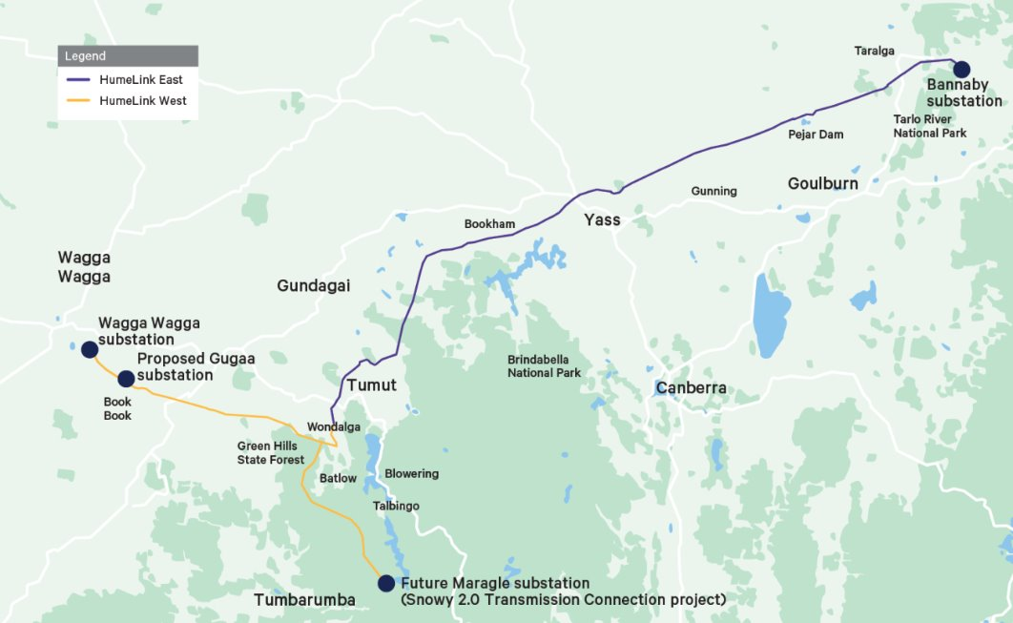
Project Overview
HumeLink is a new 500 kV transmission line which will connect Wagga Wagga, Bannaby and Maragle. It is one of the state’s largest energy infrastructure projects, with about 365km of proposed new transmission lines, and new or upgraded infrastructure at four locations.
HumeLink East will be delivered by a joint venture between ACCIONA Construction Australia Pty Ltd and Genus Infrastructure (NSW) Pty Ltd.
As we progress our works program, our core focus is establishing sustainable supply chains and delivering tangible benefits for the communities in which we work. We have a wide range of initiatives that aim to drive local business, employment and trainee participation throughout project delivery.
Figure 1: HumeLink preferred route with division of HumeLink East and HumeLink West sections.

Slide 4
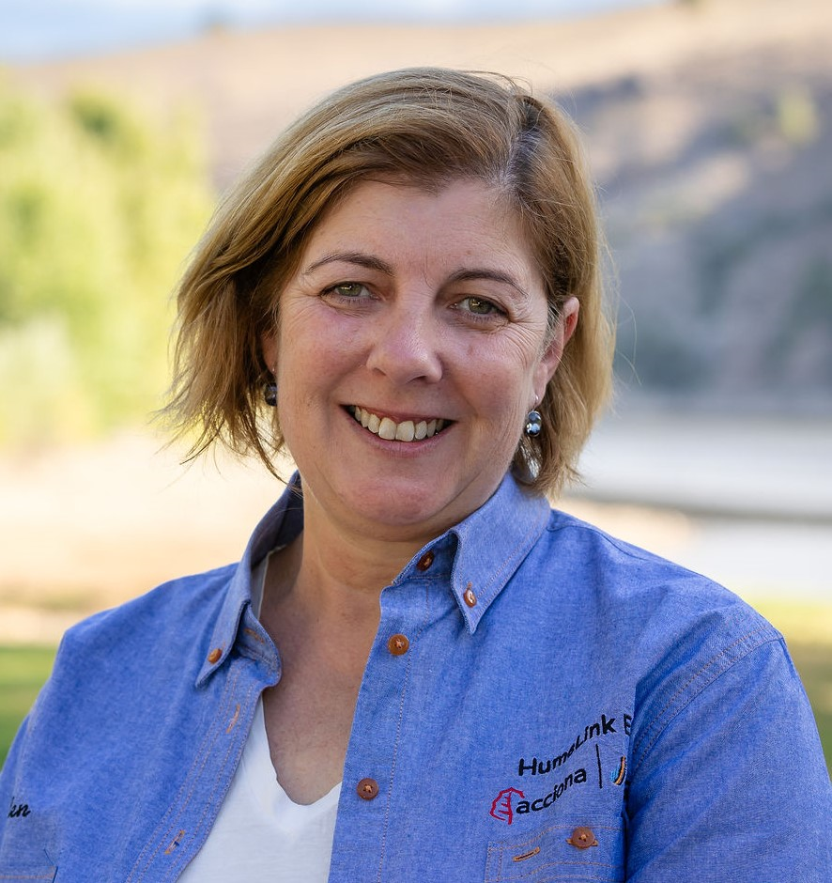
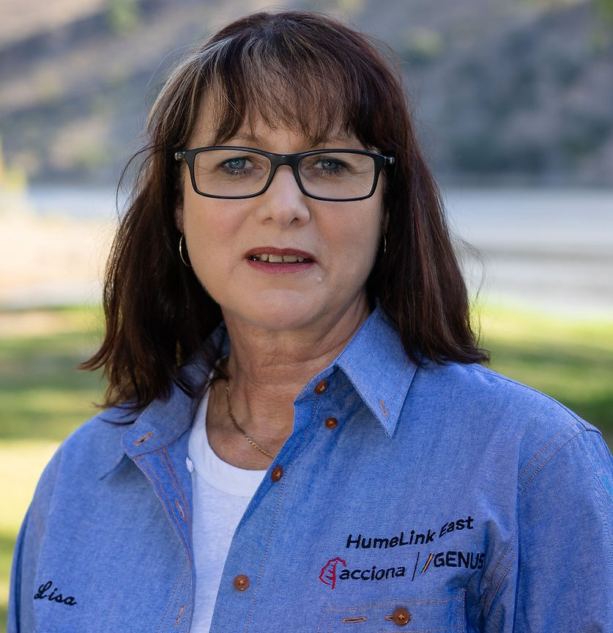
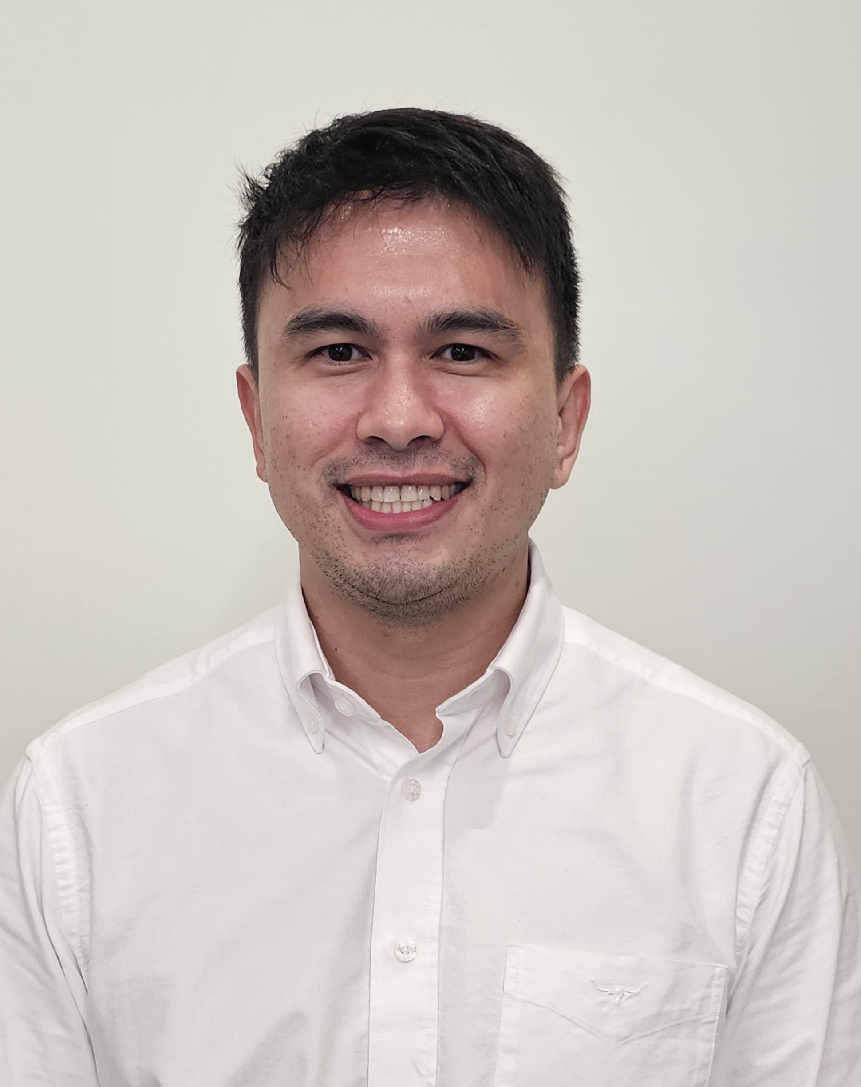
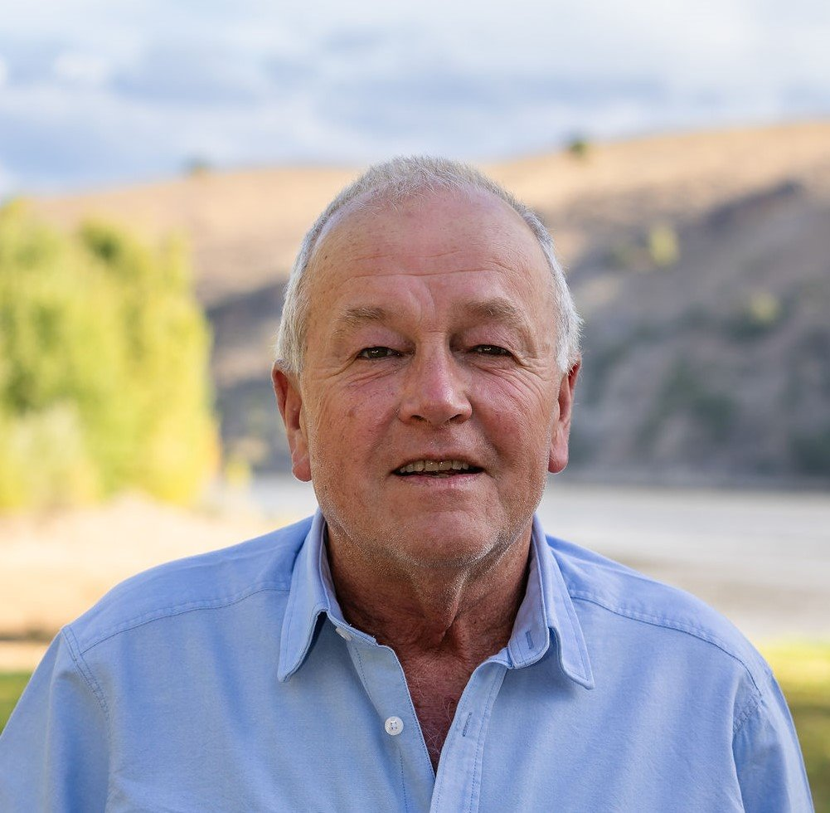
Who’s in the room?
Helen Cosgrove
Workforce Development
and Industry Participation Manager Acciona Genus Joint Venture
Lisa McIntosh
Aboriginal Participation Manager Acciona Genus Joint Venture
Yvonne Varley
Community Relations and Stakeholder Engagement Manager
Acciona Genus Joint Venture
Mark Laughton
Project Superintendent
Acciona Genus Joint Venture
Trish Nicola
Competency Advisor
Acciona Genus Joint Venture
Mark Millevoy
Procurement Manager
Transgrid

Slide 5
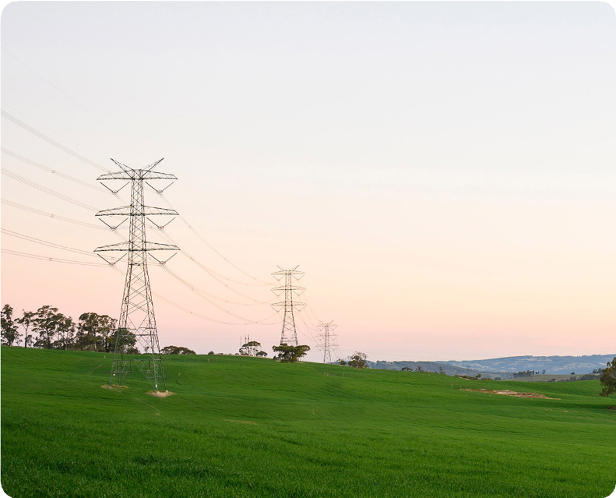
What is Business Buzz?
Business Buzz is an opportunity for you to connect in with the HumeLink East team. It's about empowering local businesses and individuals.
We promote upcoming opportunities on the ICN Gateway and today we have a member from the ICN team presenting. The ICN presentation will support you to work with us and answer your questions.
We want to hear from you so look out for our survey later in the presentation or come and chat with us at the end of this session.

Slide 6
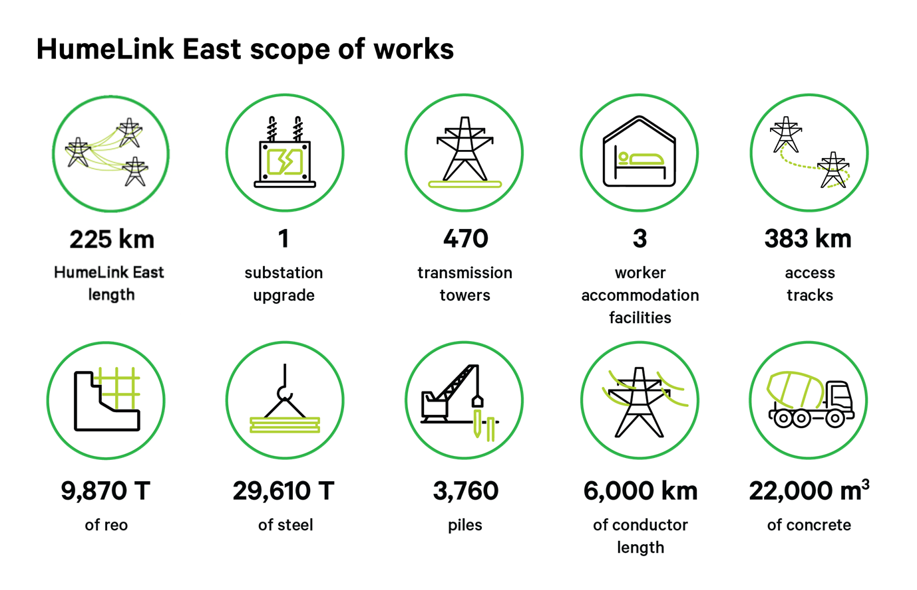

Slide 7
Upcoming Work Packages
HumeLink East has established a procurement and resourcing relationship with Industry Capability Network (ICN) to engage with local and regional suppliers to support a whole range of project activities.
Find current work packages via the ICN Gateway and the HumeLink East portal: humelinkeast.icn.org.au
Work Packages | EOI Closure | Status
Environmental Audit | 31 May 2024 | Open
Modelling Assessment | 31 May 2024 | Open
Geotechnical Investigation | 31 May 2024 | Open
Fencing | June 2024 | Future
Accommodation Facilities Security | June 2024 | Future
Accommodation Facilities Cleaning | TBA | Future
Asphalt and Bitumen Works | TBA | Future
ASP1 Hurdle Installation | TBA | Future
Waste Disposal | TBA | Future

Slide 8
Pre-Employment Opportunities
HumeLink East will offer employment, training and educational opportunities to those wishing enter our Graduate Programs, Apprenticeships and Traineeships e.g. Care for Country traineeships - Certificate II in Conservation and Ecosystem Management.
Employment opportunities may also include:
Pre-employment programs dedicated to women, youth and Aboriginal and Torres Strait Islander people where participants can gain skills to help them obtain employment​.
Mentoring for all apprentices and trainees working on HumeLink East.

Slide 9
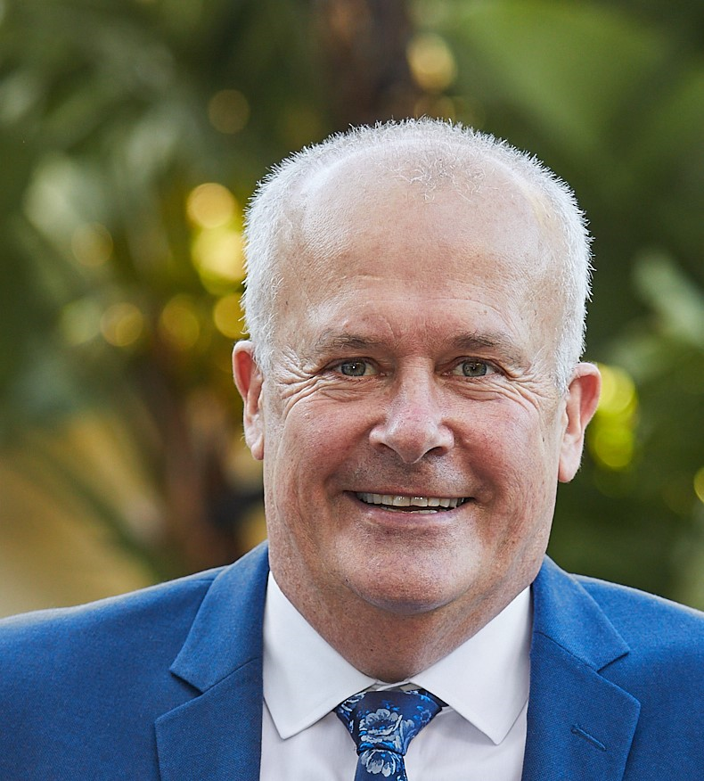
Geoff Reardon- Regional Manager
Murray Riverina
Industry Capability Network

Slide 10
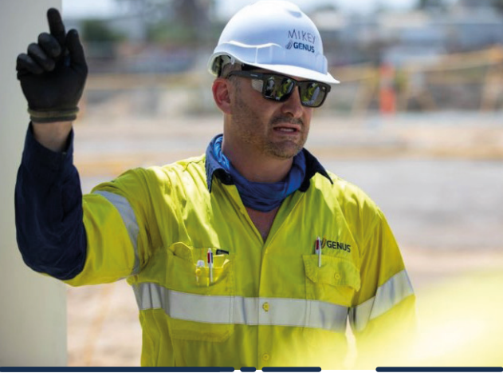
Your input matters
We would love to hear from you and understand more about your business.
Some points we can talk to are:
Business readiness workshops
Traineeships
Apprenticeships

Slide 11
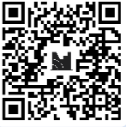
Next Steps...
Please chat with us over morning tea
Connect with us
HumeLink hotline: 1800 317 367 (free call)
Email us at: humelink@transgrid.com.au
Subscribe to our newsletter at www.transgrid.com.au/projects-innovation/humelink

Slide 12
Question Time

